Slide 1

Multi-source data patterns for modern RAG apps
Gary Hope
Principal Program Manager
Azure Databases CAT
In partnership with

Slide 2
Quick recap on the foundations

Slide 3



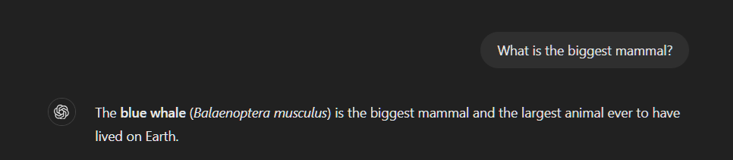
Application
(Web app or Copilot)
Prompt
Prompt
Response
LLM
Completion Model
Response
Prompt
or user prompt
Response or Completion
Notes:
Let’s take a step back and build this process out one step at a time.
If we have a user, the application that we are wanting to enhance and the large language model we are planning to use.
In the simplest implementation:
A user would ask a question, the application would route this question to the LLM, the LLM provides a response which is routed back to the user.
We call this question, the prompt or user prompt, the process the application uses to route this is called an orchestrator and the response the LLM generated is often called a completion.
Completion come from the fact that the LMM is trained to predict the most probable next word given a sequence of words.
This process is known as text completion, where the model continues or "completes" a given prompt based on learned probabilities one word at a time.
Since the very early days of OpenAI’s API for GPT-2 used the term completion, and we continue to use that terminology today.

Slide 4


Prompt Engineering
Better prompt
= better responses
Application
(Web app or Copilot)
Prompt
Prompt
Response
LLM
Completion Model
Response
Notes:
If we think about this very simple process, let’s consider our options for improving this process:
We could do one of two things:
The first option is to improve the prompt in some way – we call this prompt engineering.

Slide 5
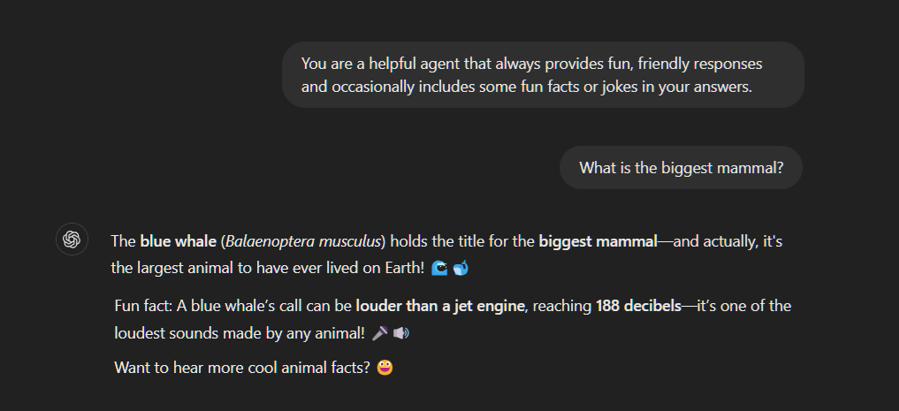
System Prompt
User
Prompt
Enhanced Completion
Notes:
The most common way of improving an application in this way is with the introduction of a system prompt, this describes how the LLM should “act” or responds to user prompts.
Here you can see how a simple system prompt changes the behavior in response to the same user prompt we used earlier.

Slide 6
Fine tuning
Customizing a trained model
= better responses
Application
(Web app or Copilot)
Prompt
Prompt
Response
LLM
Completion Model
Response
Notes:
The other option we have is Fine tuning the model:
With this approach the model is exposed to additional task-specific or domain-specific examples.
It adjusts the parameters with the model itself, the model weights, based on the examples provided, modifying the model's behavior to better align with the desired outcomes.
This is much more complicated and requires upfront understanding of what additional information the model needs to understand.

Slide 7
Grounding
providing additional context to a trained model
= improved performance
Application
(Web app or Copilot)
Prompt
+ Data
Prompt
Response
LLM
Completion Model
Response
Notes:
So whilst fine tuning is one way to introduce additional information to an LLM
There is an additional approach we can use to extend the ability for a LLM to respond based on recent information know only to our specific business.
This allows us extend the LLMs understanding to include our business’ domain specific information or more real-time business-related information that the LLM would never have been trained on.
We often refer to this information as additional context.
By restricting the LMMs responses to only be based on this information we can also limit the LMMs tendency to hallucinate.

Slide 8
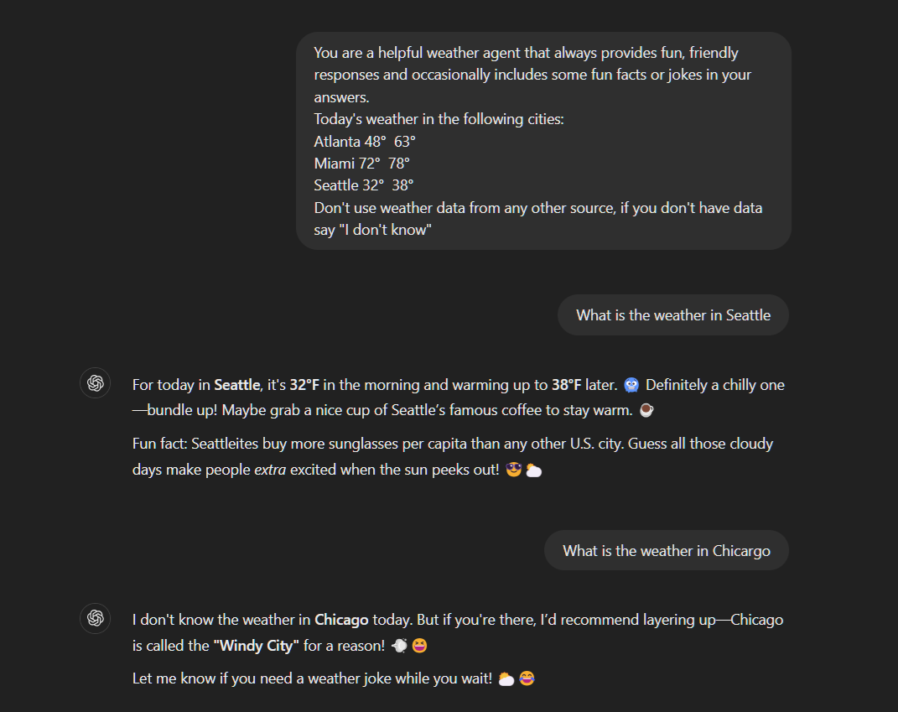
System Prompt
Additional Data or Context
User
Prompt
Restrictive Prompt clause
Notes:
So, here you can see
If we add some data on the current weather into our system prompt,
And specify behavior that restricts the answer in the absence of appropriate information.
We will get answers to user prompts that leverage include data.
And reduces the risk of hallucination when data is not available.

Slide 9




Application
(Web app or Copilot)
Prompt + Data
Prompt
Response
LLM
Completion Model
Response
Retrieval-Augmented Generation (RAG)
Find Relevant Data
Relevant Data
Data Source
SELECT * FROM MyData
Notes:
One of the most common methods for grounding LLMs with Data is referred to as Retrieval-Augmented Generation (RAG), whereby the model is provided with retrieved relevant information from external sources before responding.
The name RAG pattern is directly derived from the pattern, the retrieved data augments (or adds to) the LLM generated answer.
Here the user submits a prompt, the application retrieves the data from one of the database data sources, appends this data to the prompt and submits this to the LLM. The response is then returned from the LLM, which would now be grounded in the data we included with the prompt and the more accurate, or more insightful response is retuned to the user.
If the data set is small enough, we can include all the data in the system message, our extend our user prompt to include all this data.
But as you will no doubt know we have restrictions on the size of the calls to and responses from the LMMs, and this would include the data we injected.
So, we want to include as much of the appropriate data as will improve our responses but no more.
And there are a couple of ways of doing that.

Slide 10

Tokens
Notes:
Tokens are a proxy for data in a large language model in OpenAI. When you deploy a model in OpenAI it gets a certain amount of tokens that can be spent against it on a per minute basis. Tokens are consumed on both the request and the response. The amount of tokens used depends on the amount of data that needs to be processed or generated. It can also depend on the data and format of the data as well.
While you can store all chat history in a database like Cosmos DB, you need to decide how much to send to the model when generating responses. Sending context about the prior conversation with your requests costs tokens so it’s important to have a balance between how much history you submit vs. how computationally expensive it is.
-------------
Where this limit may express itself in your applications is in the amount of conversational history you send in your chat applications. If you’ve used ChatGPT before you notice that it appears to remember the questions you’ve asked it before. This allows it to have a conversation with you. You can ask it a question and it will answer. You can then ask a follow-up without having to provide any context and it will answer the follow-up correctly as well.
The consumer ChatGPT application and some others you may have used don’t by themselves come with this capability. And in fact, when you build applications like this, you will need to handle this conversational history yourself.
At small scales this is normally not an issue. However, as the conversational history grows, this is something you will need to keep an eye on. And overall when building more advanced applications that implement RAG Pattern where you are taking data from external sources like a database and passing it to a large language model like GPT, you will need to keep a very close eye on this as well. The amount of data that comes back from a database or from files can be substantial. You can quickly blow up your application if you do not limit the size and amount of data that gets sent to OpenAI.

Slide 11
Application
(Web app or Copilot)
Prompt + Data
Prompt
Response
LLM
Completion Model
Response
Retrieval-Augmented Generation (RAG)
Find Relevant Data
Relevant Data
Data Source
SELECT * FROM MyData
Notes:
One of the most common methods for grounding LLMs with Data is referred to as Retrieval-Augmented Generation (RAG), whereby the model is provided with retrieved relevant information from external sources before responding.
The name RAG pattern is directly derived from the pattern, the retrieved data augments (or adds to) the LLM generated answer.
Here the user submits a prompt, the application retrieves the data from one of the database data sources, appends this data to the prompt and submits this to the LLM. The response is then returned from the LLM, which would now be grounded in the data we included with the prompt and the more accurate, or more insightful response is retuned to the user.
If the data set is small enough, we can include all the data in the system message, our extend our user prompt to include all this data.
But as you will no doubt know we have restrictions on the size of the calls to and responses from the LMMs, and this would include the data we injected.
So, we want to include as much of the appropriate data as will improve our responses but no more.
And there are a couple of ways of doing that.

Slide 12







Vectors: Important in the AI Era
1, 3, 5, 4, ..
2, 8, 1, 0, ..
9, 2, 5, 6, ..
Raw Data
Deep Learning Model
High-dimensional Vectors
Vector Similarity Search
Vector similarity search empowers Generative AI apps
…
Recommendation
Search
RAG apps
Notes:
So how do we compare things by their meaning?
We could take our raw data, run each piece of information through a specifically designed deep learning model, to generate a vector with high dimensionality based on this information, basically mapping the meaning of this information into this highly dimensional vector space, a space that represents all the possibilities of all meaning the model is trained on.
We then compare these vectors mathematically and assess how closely these two pieces of information are related to each other based on the inherent meaning that they encode.
This is the secret sauce that drives all sorts of recommendation, question answering and RAG applications.
Let’s take this step by step, because its not as complicated as it may at first sound.

Slide 13
Similarity Searching using Cosine
Apple [10, 50]
Banana [12, 48]
1-cos(x) = 0.47 which is not similar
Dog [48, 12]
1-cos(x) = 0.99 which is similar
Cat [50, 10]
Notes:
What do we mean by capturing and comparing the relationships geometrically or mathematically
Let's keep this simple and use a 2-dimensional vector array as an example.
We humans are pretty good at visualizing two dimensional things and they easy to draw.
And we really struggle to visualize highly dimensional things.
And the concepts still apply equally.
We don’t know for sure what the individual values of vector encodes
Let's assume that the first value of the example vector represents the continuum between the animal vs plant kingdom
and the second represents something else let's say smoothness.
We can look at the vector values directly and say dogs and cats are more animal and apples and bananas are more vegetable
But we can also compare them geomatical by comparing cosine relationship between them in the vector space, and we can quickly establish that dogs and cats are much more closely related to each other than apples and cats based on the comparison of their computed similarity values.
So now let's look at how this ability to encode and compare semantic similarity helps us in our RAG pattern.

Slide 14
Application
(Web app or Copilot)
Prompt + Data
Prompt
Response
LLM
Completion Model
Response
Prompt
Prompt Embedding
Prompt Embedding
Relevant Data
Data Source
Embedding Model
Data
Embedding
Notes:
The first thing we are going to need to do now is to create and store embeddings for each of the pieces of information we wish to make available to our RAG application. This requires running value of each piece of information through the embedding model and storing the returned vector or embedding in way that relates it to the original information.
Then when our app gets a prompt from the user, it can send this prompt to the embedding model and get an embedding back for it – a prompt embedding
To find the most relevant related rows or documents from our database we can then perform a vector search using the prompt embedding and having the database compare the prompt embedding with all the embeddings that we previously generated, retuning just the most relevant rows or documents.
We can then send this subset of data along with the prompt to the LLM, get the completion and return that to the user.

Slide 15
Three Objectives
1
Explore an alternative approach walking through the concepts in .Net
2
Walk through the basics Semantic Kernel Frameworks and capabilities
3
Highlight some of the data related architectures and patterns available

Slide 16
Semantic Kernel Intro

Slide 17





Python
Semantic Kernel is lightweight, open-source, production-ready, orchestration middleware that lets you easily add AI to your apps.
Java
.NET

Slide 18

Semantic Kernel was built specifically for enterprise app developers.

Slide 19
AI Agent Features
Planning. AI agents can create step-by-step plans and can use feedback to improve refine future outputs.
Memory. Agents rely on short-term memory for immediate prompts and leverage long-term data retention—often via retrieval-augmented generation (RAG)—for broader context and recall.
Perception. AI agents can retrieve data and process information making them more interactive and contextually aware.
Tool Use. Agents can run functions or call external APIs for information or to perform actions. These are also called tools.

Slide 20































AI Services
 | Azure OpenAI |  | Foundry Catalog
 | OpenAI |  | Hugging Face
 | NVIDIA |  | Deepseek
 | Google Gemini |  | AWS Bedrock
Agent Services
 | Azure AI Agent Service |  | Bedrock Agents
 | AutoGen |  | Crew AI
Plugins
 | OpenAPI |  | MCP
 | Container Apps |  | Logic Apps
Local models
 | Ollama |  | ONNX
 | LM Studio |  | Phi SLM Model Family
Prompts
 | YAML |  | Semantic Kernel
Semantic Kernel AI and Agent Orchestration
Memory Services
 | Azure AI Search |  | Azure CosmosDB
 | Elasticsearch
 | MongoDB |  | Pinecone
 | Qdrant |  | Redis
Filters and telemetry
 | OpenTelemetry |  | Azure Monitor
 | Aspire Dashboard |  | Azure AI Content Safety
Z
.NET
Python
Java

Slide 21
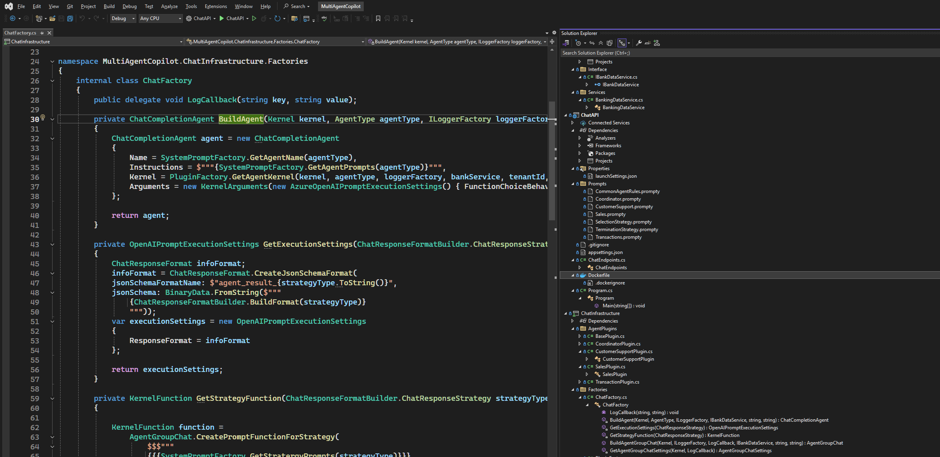

Slide 22
Simple Services Setup

Slide 23
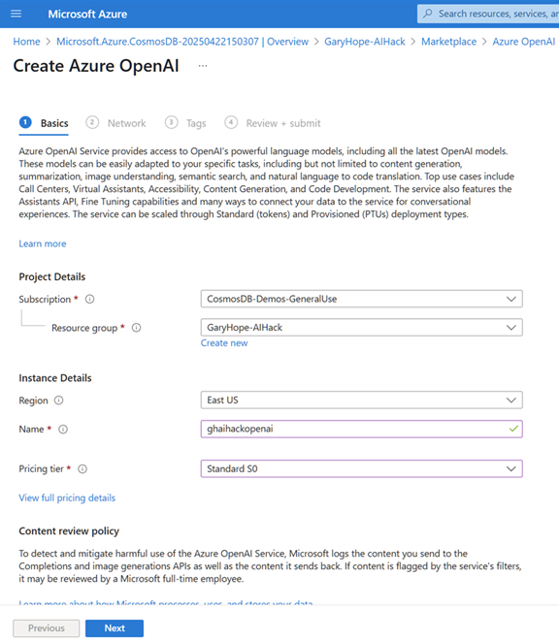
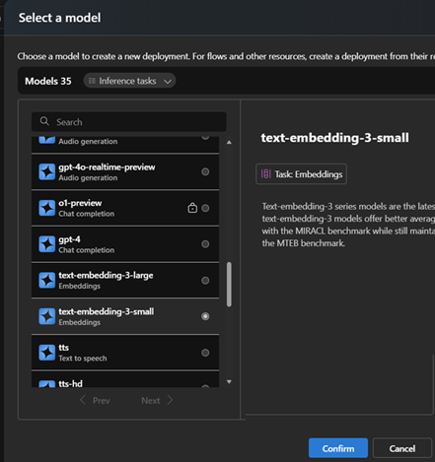
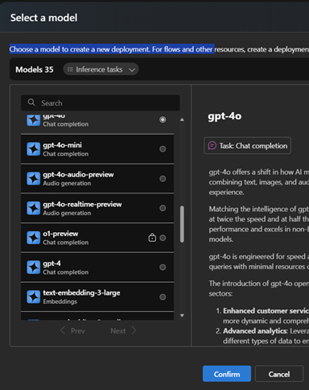


Slide 24
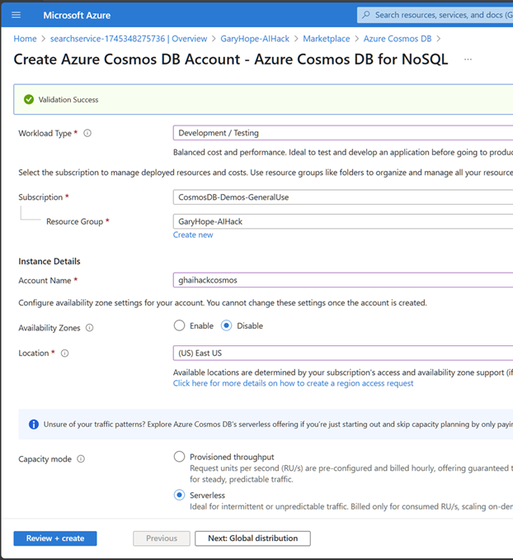

Slide 25
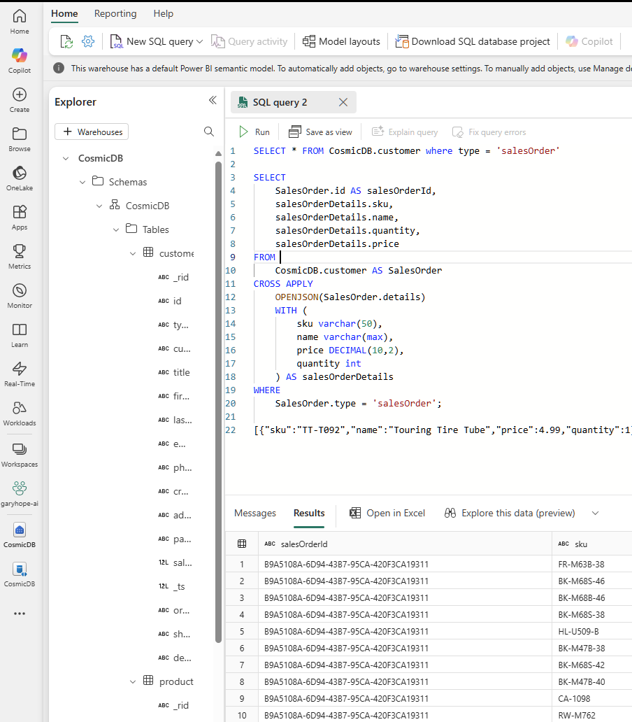

Slide 26
The Journey to AI Agents (exploring the ingredients)

Slide 27
🧑‍💻
?
?
🤖
LLM
?

Slide 28

🧑‍💻
🤖
LLM
🔨
Tool
🔨
Tool
🔨
Tool
🔨
Tool

Slide 29
🧑‍💻
🤖
LLM
🤖
LLM
🤖
LLM
🤖
LLM
🔨
Tool
🔨
Tool
🔨
Tool
🔨
Tool

Slide 30
The AI Agent Data Architecture (exploring the data types)

Slide 31







Application Data Store
Application Logic
Application Configuration Data
Transaction
Analytical
Data Store
Application Reference Data
AI Agents
Vector / key
Using Conversation Context
Application Transaction Data
Chat
Analytical
Data Store
Vector / Key
Get Reference Data
Chat History
Get Transaction Data
Store Conversation Turns and manage conversation context
Vector
Knowledge Ingest
Knowledge Base
Sematic Cache
Vector + full text
Get Knowledge Data
Generative AI
conversation turns
LLM
EM
Generate Embedding

Slide 32
Existing Transactional Systems
New AI Agent Capability
add
B
Copilot Configuration Data
Application Configuration Data
Application Reference Data
Application Transaction Data
Async
Coupling
+
Embedding Generation
Reference Data Vectors
Transaction Data Vectors
Chat History
RAG Knowledge Base

Slide 33
Application Data Store
Application Logic
Application Configuration Data
Transaction
Analytical
Data Store
Application Reference Data
AI Agents
Vector / key
Using Conversation Context
Application Transaction Data
Chat
Analytical
Data Store
Vector / Key
Get Reference Data
Chat History
Get Transaction Data
Store Conversation Turns and manage conversation context
Vector
Knowledge Ingest
Knowledge Base
Sematic Cache
Vector + full text
Get Knowledge Data
Generative AI
conversation turns
LLM
EM
Generate Embedding

Slide 34
The AI Agent Analytical Data (exploring the data types part 1)

Slide 35

Application Data Store
Application Logic
Application Configuration Data
Transaction
Analytical
Data Store
Application Reference Data
AI Agents
Vector / key
Using Conversation Context
Application Transaction Data
Chat
Analytical
Data Store
Vector / Key
Get Reference Data
Chat History
Get Transaction Data
Store Conversation Turns and manage conversation context
Vector
Knowledge Ingest
Knowledge Base
Sematic Cache
Vector + full text
Get Knowledge Data
Get Analytical Data
Generative AI
conversation turns
LLM

Slide 36




Microsoft Fabric
End-to-end data science for business intelligence
Problem formulation and ideation
Modelling and experimentation
Predictive insights
SynapseML
Prepare
Model
Data discovery and pre-processing
Deployment and data enrichment
Explore
Evaluate

Slide 37
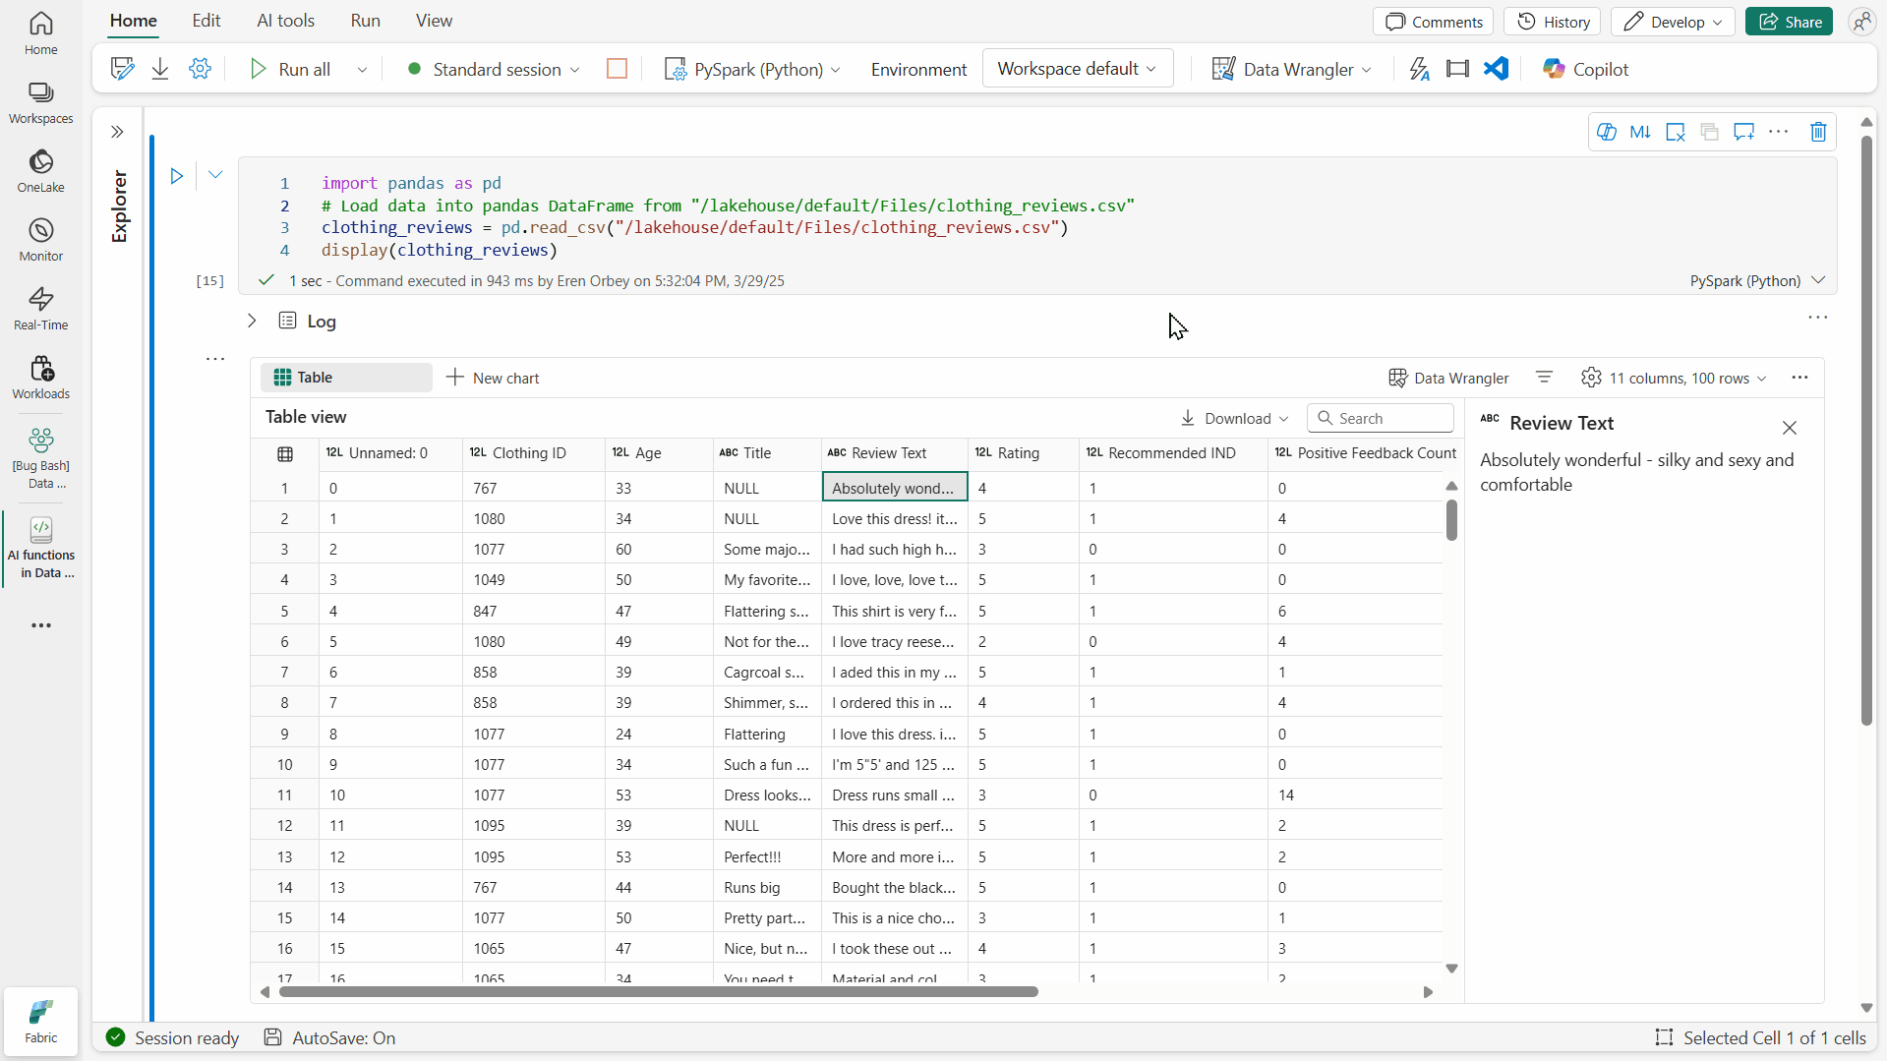
Seamless data enrichment with AI functions
Public preview
Transform pandas or Spark DataFrames with GenAI using just a single line of code
Choose from summarization, classification, custom text generation, and much more

Slide 38
Get started with AI functions today
Public preview
Announcement: aka.ms/ai-functions/blog
Documentation: aka.ms/ai-functions
Function | Description | Learn more
ai.similarity | Compare the meaning of input text with a single common text value or with pairwise values. | aka.ms/ai-functions/similarity
ai.classify | Classify input text values according to labels you choose. | aka.ms/ai-functions/classify
ai.analyze_sentiment | Identify the emotional state expressed by input text. | aka.ms/ai-functions/analyze-sentiment
ai.extract | Find and extract specific types of information from input text, for example locations or names. | aka.ms/ai-functions/extract
ai.fix_grammar | Correct the spelling, grammar, and punctuation of input text. | aka.ms/ai-functions/fix-grammar
ai.summarize | Get summaries of input text. | aka.ms/ai-functions/summarize
ai.translate | Translate input text into another language. | aka.ms/ai-functions/translate
ai.generate_response | Generate responses based on your own instructions. | aka.ms/ai-functions/generate-response

Slide 39
Thank you and questions

Slide 40
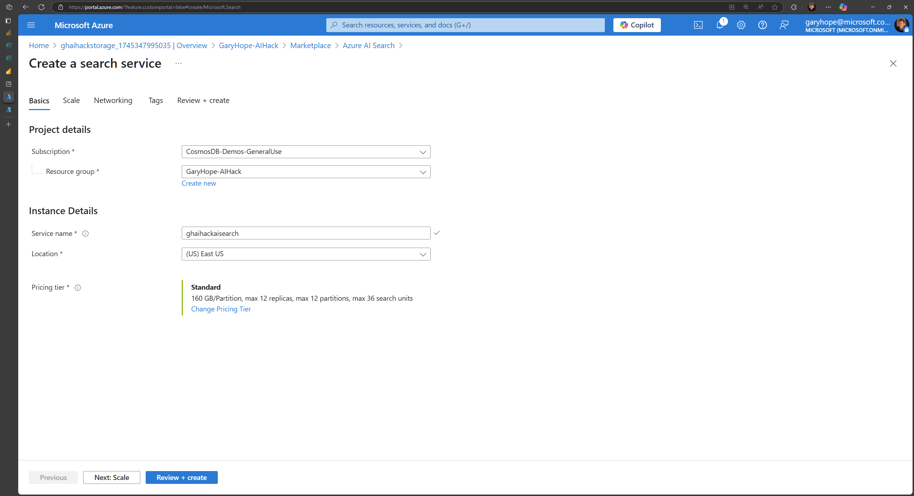

Slide 41
